Slide 1







NJEIF
Fall Sub-fund Meeting
Friday, Sept. 25, 2026 | 12pm - 3pm
From Risk to Resilience:
Protecting Our Schools, Strengthening Our Legal Obligations & Preparing for Tomorrow

Slide 2


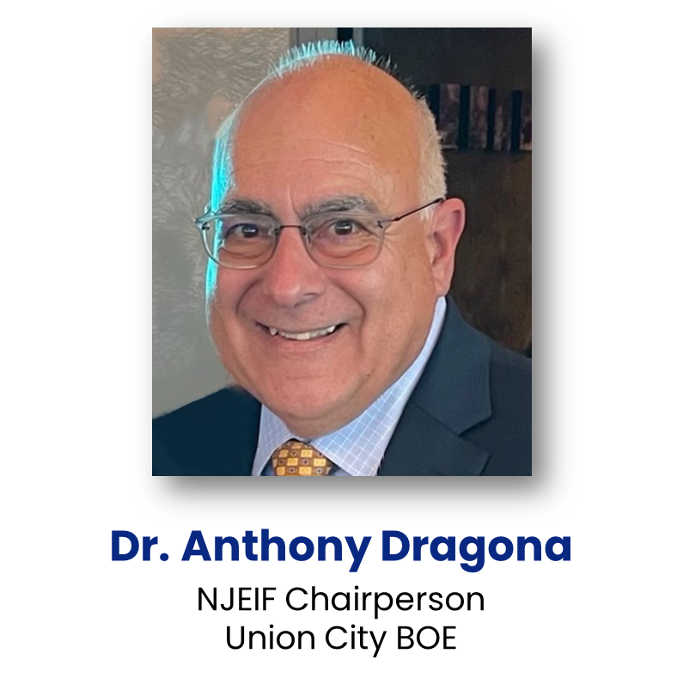

WELCOME
Dr. Anthony Dragona
NJEIF Chairperson
Union City BOE

Slide 3

2 QPA Credits:
Continuing
Education
Credits
  1 Procurement Procedures
  1 General Duties
Certificates will only release at the end of the program and receipt of Completed Evaluation Form.
Must be present for the entire program.
REMINDER!
1 = GOOD/AGREE
4 = BAD/DISAGREE

Slide 4
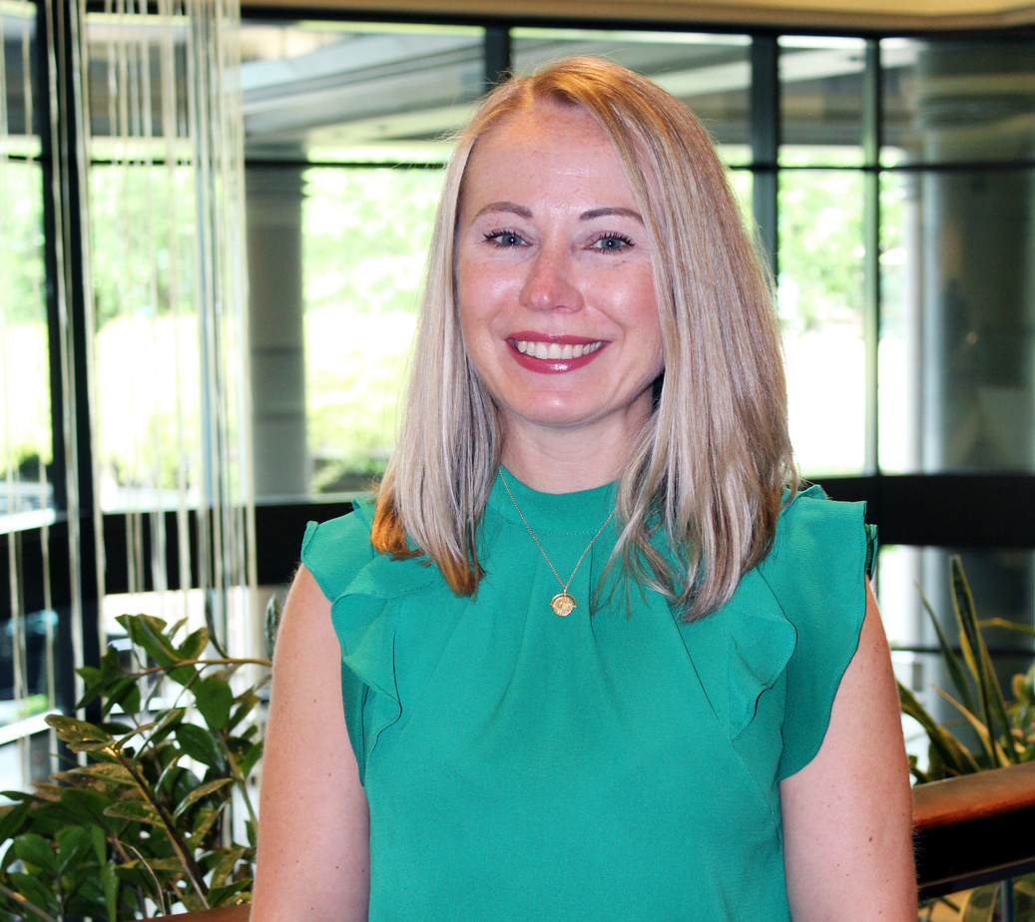
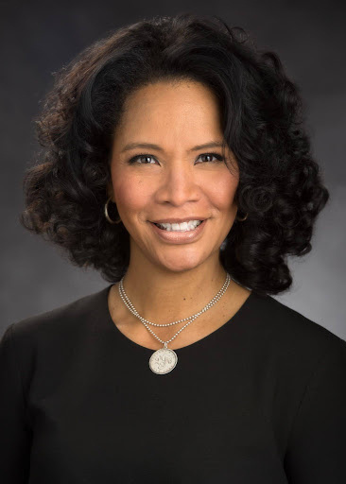
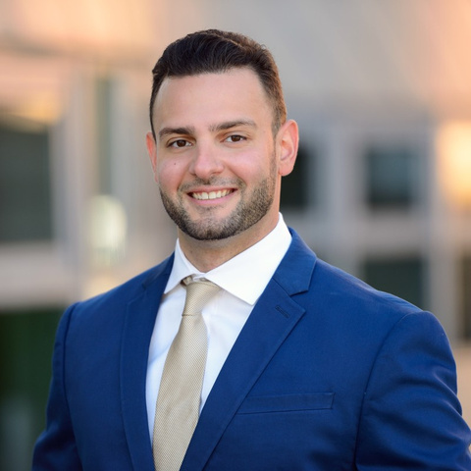
Sub-fund Administrator’s Report
Eva Jakowluk
Latonya Brennan
NJEIF Sub-fund Administrator
Area Executive Vice President,
Public Entity, Regional Director,
AJG NJ North
Anthony Ciprani

Slide 5


Capehart Scatchard
Workers’ Compensation Newsletter
New Jersey School Law Central
Newsletter
  Created exclusively for NJSIG members!
  Breaks down key areas of New Jersey workers’ compensation law that every school district should know.
  Provides practical guidance to help districts:
    Navigate workers’ compensation claims
    Protect employees
    Manage costs
    Take a more proactive approach to workers’ compensation risk
  Written by New Jersey school law experts.
  Supported by school risk management professionals.
  Provides school business officials and administrators with practical insight into:
    Current legal challenges
    Emerging legal issues
    Risk management considerations

Slide 6

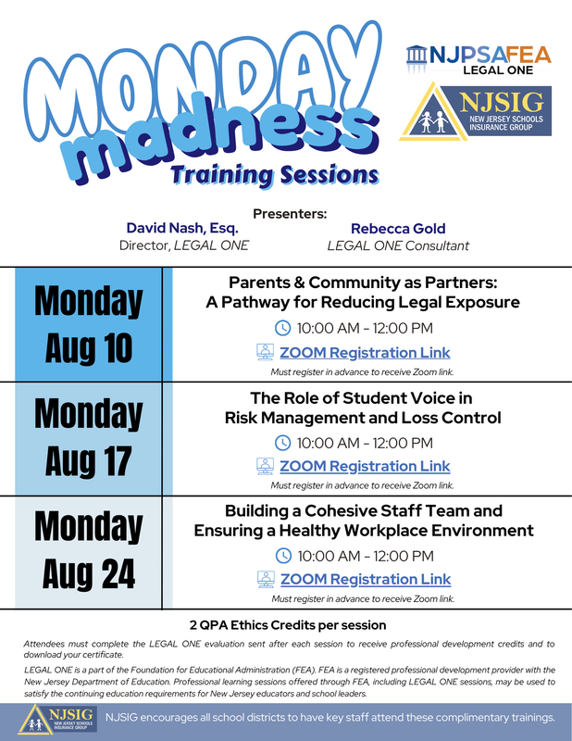
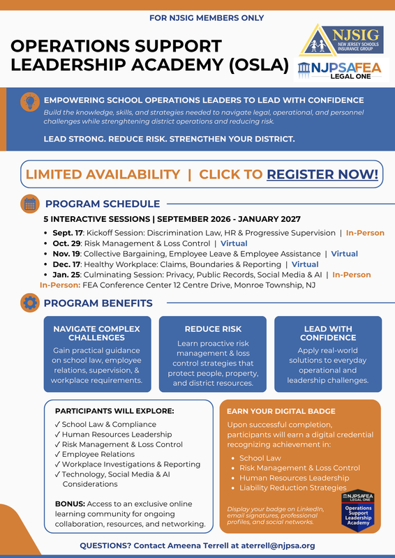
LEGAL ONE Trainings
Operations Support Leadership Academy (OSLA)
Monday Madness
Training Sessions
LEGAL ONE
Podcast

Slide 7

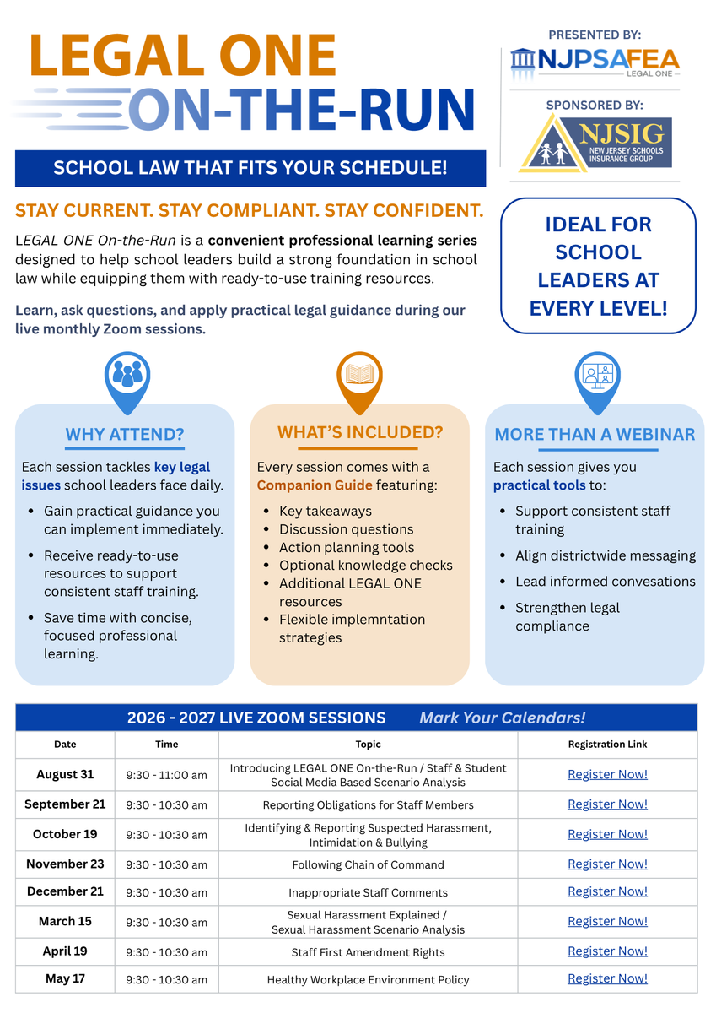
Designed for busy school leaders, LOOR delivers practical, focused professional development in convenient one-hour virtual sessions. Each session includes a ready-to-use Companion Guide, making it easy for principals, supervisors, and department leaders to bring the conversation—and the learning—back to their own teams.
Upcoming Virtual Sessions | 9:30–10:30 a.m.
  September 21: Reporting Obligations for Staff Members
  October 19: Identifying & Reporting Suspected Harassment, Intimidation & Bullying
  November 23: Following Chain of Command
  December 21: Inappropriate Staff Comments
  March 15: Sexual Harassment Explained & Scenario Analysis
  April 19: Staff First Amendment Rights
  May 17: Healthy Workplace Environment Policy

Slide 8

Training Thursdays with
NJ Division on Civil Rights
Reasonable Accommodations in the Workplace & the Law Against Discrimination
NJ’s Law Against Discrimination
in the Workplace
Thursday, February 25, 2027 | 10am to 12pm
Explore how New Jersey’s Law Against Discrimination protects employees—and what supervisors need to know. Through real-world scenarios, participants will tackle discrimination, harassment, accommodations, retaliation, wage equity, and the supervisor’s role in creating a fair and inclusive workplace.
Thursday, March 25, 2027 | 10am to 12pm
What does a reasonable accommodation really look like in the workplace? Through real-world scenarios and interactive exercises, this training explores NJLAD requirements, the interactive process, disability and pregnancy accommodations, undue hardship, telework, and other common accommodation challenges.
Contact Latonya Brennan for registration links.

Slide 9
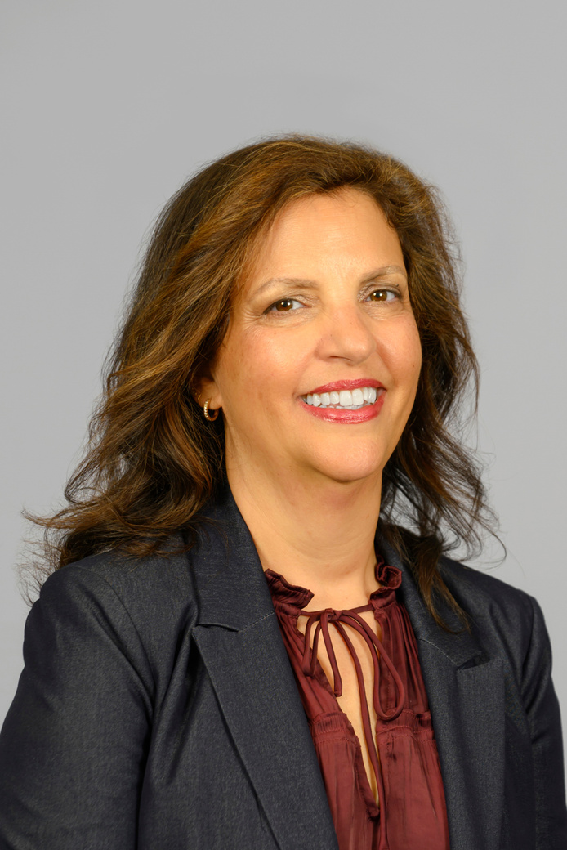
NJSIG Executive Update
Jill Deitch, Esq.
NJSIG Executive Director

Slide 10
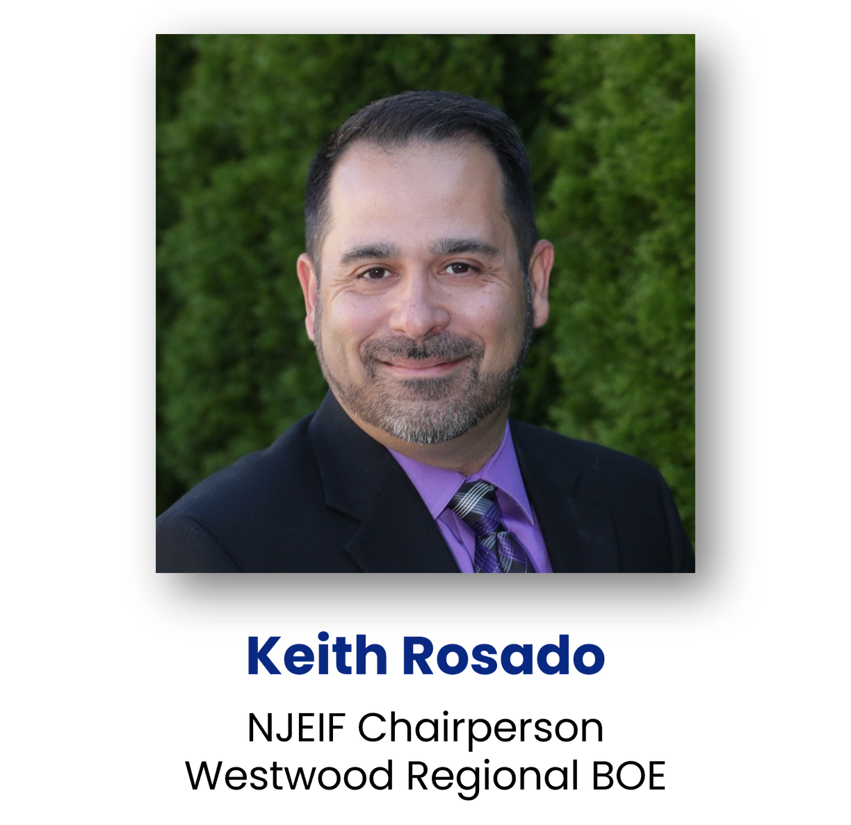
Question
& Answers
Keith Rosado
NJEIF Chairperson
School Business Administrator
Board Secretary
Westwood BOE

Slide 11

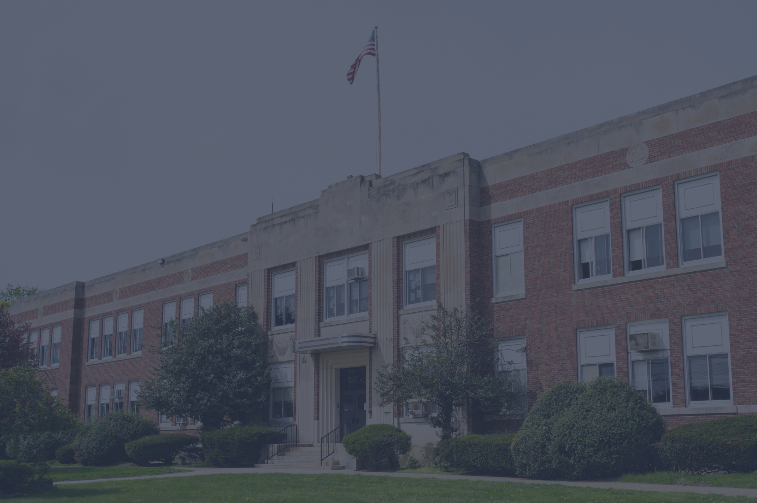
NJ PEOSH
Darcea Messier
Assistant Chief PEOSH Consultation & Training
Alicia Stephens
PEOSH Consultation &Training

Slide 12
NJSIG
Sherwin Archibald
NJSIG Claims Manager
Anthony Fernandez
NJSIG Errors & Omissions Supervisor
Shevon Bennett
NJSIG Underwriting Supervisor
Joanna Radomicki
Sr. Member Services & Loss Control

Slide 13

Learning from Claims: Practical Lessons for NJSIG Members
Sherwin Archibald M.B.A./H.C.M.
NJSIG Claims Manager

Slide 14

From Risk to Resilience:
What School Districts Can Learn from Real-World Claims
  Real-world claims. Real-world lessons.
  What happens when something goes wrong?
  What drives a favorable outcome?
  What can districts do before a claim occurs?

Slide 15

Property Losses: Speed Matters
  Shut down the source of damage immediately.
  Begin mitigation as quickly as possible.
  Document the condition and timeline.
  Preserve failed equipment or components.
  Identify the cause, not just the damage.
  Communicate early with claims and restoration professionals.

Slide 16
Liability Claims:
Preserve the Facts
  Report incidents promptly.
  Preserve video and other evidence.
  Identify witnesses.
  Document the incident.
  Avoid speculation about fault.
  Involve risk-management/claims professionals early.

Slide 17
Auto Claims:
The Investigation Starts at the Scene
  Notify the district promptly.
  Preserve dashcam/video evidence.
  Follow established accident procedures.
  Avoid assumptions about fault.
  Key documentation, including bus video, police report, and incident reports.
  Being available for trial.

Slide 18
Auto Risk:
Know Who Is Authorized to Drive
  Establish clear authorization to operate district vehicles.
  Verify valid driver’s licenses.
  Review driving records as required.
  Maintain appropriate driver controls.
  Follow district vehicle-use policies.
  Keep driver information current.

Slide 19
Crime Claims:
Trust Requires Controls
  Establish strong internal controls.
  Separate financial responsibilities.
  Reconcile accounts regularly.
  Conduct periodic audits.
  Limit access to cash and financial assets.
  Preserve records and surveillance.
  Verify, don’t rely solely on trust!

Slide 20
Errors & Omissions:
Decisions Create Exposure
  Document significant decisions.
  Document the reasoning, not just the outcome.
  Maintain important communications with the employee.
  Seek strategic guidance and risk analysis with NJSIG.
  Communication-giving consent timely.

Slide 21
Employment & Ethics:
Consistency Matters
  Apply policies consistently.
  Document employment-related decisions.
  Avoid decisions based on incomplete information.
  Address conflicts and governance concerns appropriately.
  Treat complaints seriously before they escalate.
  Protect public trust!

Slide 22
Equipment Breakdown:
Know Before You Act
  Use trained personnel for specialized equipment.
  Follow established operating procedures.
  Maintain preventive maintenance programs.
  Keep inspection records.
  Document repairs and service.
  Notify claims/risk-management promptly.

Slide 23
From Claim to Resilience:
10 Practices That Strengthen Claim Outcomes
  Report early
  Preserve evidence
  Document thoroughly
  Mitigate quickly
  Follow established procedures
  Don’t speculate about fault
  Investigate promptly
  Communicate clearly
  Engage the right professionals early
  Know your coverage and responsibilities

Slide 24
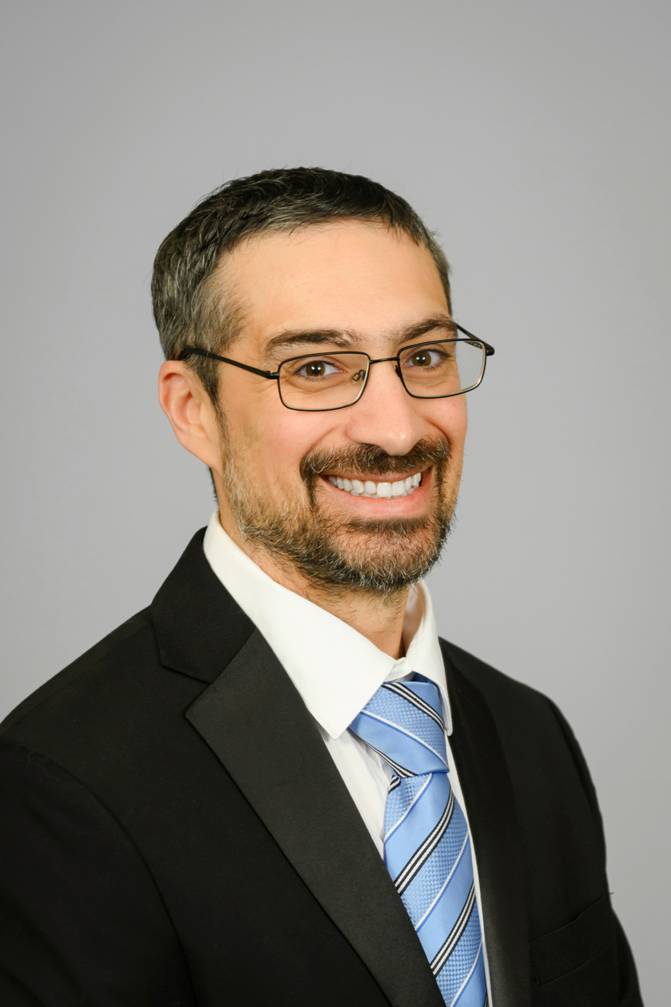
Policy & Contracting
Tony Fernandez
NJSIG Claims Supervisor (E&O)
Senior Policy and Claims Analyst

Slide 25
Policy Updates
Property:
  $25,000 per occurrence give back for wind-driven rain.
  Property per occurrence limits increasing from $400M to $500M.
  Co-insurance clause – requiring a 95% insured to value. Next year, 100%.
  Added business income & Loss of rents at no additional cost.
  90-day notification policy for members to report policy claims.
E&O:
  Added an exclusion for claims arising out of taxes, fines, penalties including failure to anticipate tax revenue shortfalls.
Cyber:
  Updated language to specify that backups must include all essential information and systems critical to normal operations and business continuity.
Notes:
Reminder: Report within 90 days

Slide 26

Trends
Cyber:
  Price of bitcoin ransomware claims
  Social engineering / fraudulent instruction claims
E&O:
  Special education administrative claims (due process etc.)
    NJSIG panel counsel list – RFP process
    Claims made/reported policy – report administrative filings
    Navigating Special Education Claims: Pitfalls & Best Practices with Eric Harrison, Esq.
      NJSBA Workshop 2026 | Wednesday, 10/21 | 11:30am & 2:00pm
  Employment claims and HIB matters
    NEPHA hotline – free legal advice for E&O Members

Slide 27
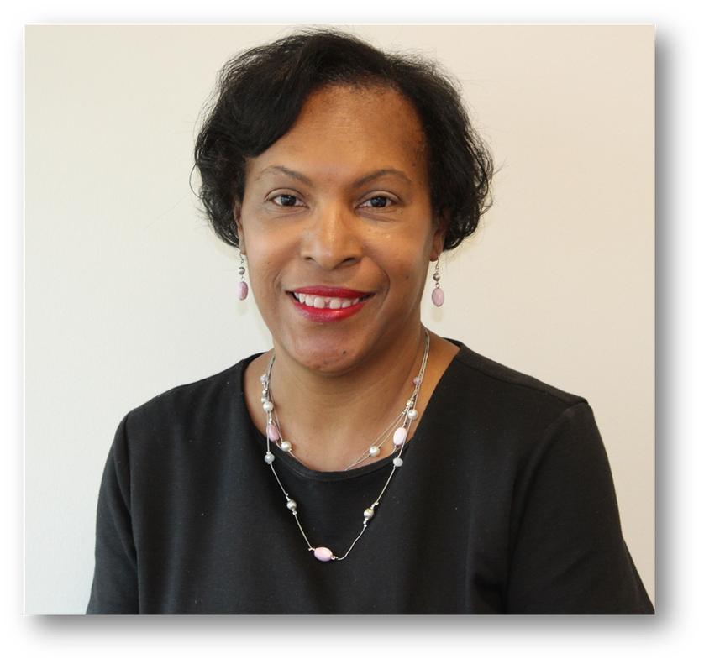
Certificate of Insurance
Shevon Bennett, AU, AU-M
NJSIG Underwriting Supervisor

Slide 28
Purpose
  Certificates of Insurance: Provides quick, verified proof of active insurance coverage.
  Contract Requirements: Confirms that insurance requirements are met under a contract or agreement.
  At-a-Glance Summary: Provides key information, including:
    Policy limits
    Effective dates
    Types of coverage

Slide 29
Importance
  Protects the District: A COI helps verify that hired contractors and vendors have appropriate insurance coverage.
  Protects Against Out-of-Pocket Costs: Proper insurance can help protect the district when a contractor or vendor causes property damage or injury.
  Before Work Begins: Many leases, project bids and agreements require a valid COI before work can start.

Slide 30
Suggested Minimum Limits
  Workers’ Compensation
    Statutory coverage, including occupational disease, as required by New Jersey law
    Covers all individuals providing services under the contract
  Employers’ Liability
    $1,000,000 each accident — bodily injury by accident
    $1,000,000 policy limit — bodily injury by disease
  Commercial General Liability
    $1,000,000 each occurrence
    $2,000,000 aggregate
This is not risk management advice. Suggested insurance limits are based on the scope and nature of the vendor’s services and intended use. Appropriate limits may vary based on the specific contract, exposures, and circumstances. Consult your broker or risk manager for guidance on appropriate limits and any questions regarding NJSIG coverage.

Slide 31
Suggested Minimum Limits
  Errors & Omissions (E&O)
    $1,000,000 per claim
    $2,000,000 aggregate
  Crime
    $1,000,000 minimum
    Employee dishonesty, theft, robbery, forgery and other dishonest acts
This is not risk management advice. Suggested insurance limits are based on the scope and nature of the vendor’s services and intended use. Appropriate limits may vary based on the specific contract, exposures, and circumstances. Consult your broker or risk manager for guidance on appropriate limits and any questions regarding NJSIG coverage.

Slide 32
Third-Party Contracts
& Insurance: Best Practices
RFP/Bid Process
  Make sure insurance requirements are outlined in the RFP/Bid.
    Ensure GL is required for transportation vendors.
  Require certificates of insurance for evidence of insurance limits in response.
    Ensure that the policy covers the time period of the project/operation.
  Require that a certified copy of the policy is available upon request.
  Leverage your board counsel!
  Review of RFP/Bid Responses
    Carefully review responses to make sure that the vendors have provided
the required insurance documents.

Slide 33
Contracts with
Vendors / Third Parties
  Terms of the contract should require the Board be added as an additional insured on the Vendors’ insurance policies.
  Certificates of insurance with additional insured language
    Certificates are proof of coverage, the contract and the insurance policy are what controls!
  30-day notice of insurance cancellation requirement.
  Hold Harmless / Indemnification Agreement in favor of the Board
  Board counsel needs to review all contracts!
  Whenever possible – seek the strongest possible indemnification language!

Slide 34
What is the strongest indemnification language?
Example:
  Azurak Compliance
    Vendor to defend and indemnify the district even if the district is potentially liable
  Without this language, the vendor is not required to defend and indemnify the district for the district’s alleged or actual negligence.
12. Indemnification. The Contractor agrees to indemnify, save and
hold harmless the Board of Education, its departments, agencies,
board, officers, officials, agents, servants, administrators and
employees, from and against any and all claims, demands, suits,
damages, liability costs and expenses, including reasonable
attorneys fees arising out of or resulting from or in any way related
to the Contractor’s performance of this Agreement or any personal
injury or property damage, resulting from negligent acts or
omissions, whether intentional or unintentional or willful
misconduct on the part of the Contractor, the Contractor’s agents,
servants or subcontractors in the delivery of goods and services, or
in the performance of the work under the contract whether such
liability is direct or vicarious. Contractor further agrees to
indemnify any and all indemnities for their own negligence,
regardless of whether such negligence is responsible wholly or in
part for the damages suffered or in the case of lawful termination of
the contract by the District. The District may defend itself at the
Contractor’s expense from any claim or lawsuit whatsoever that
may arise as described in this paragraph or the District may elect to
have the Contractor provide the District with a defense at the
Contractor’s expense. This provision shall be construed as broadly
in favor of indemnification as permitted by New Jersey law and shall survive termination of this Agreement.

Slide 35
Charter Schools
& Management Companies
  Management companies often provide operational services to charter schools.
  Contracts typically require each party to provide a Certificate of Insurance.
  Additional Insured status should be clearly addressed in the contract.
  COIs should clearly distinguish liability for each party’s own negligence.
  Contracts should include appropriate “sole negligence” language when applicable.

Slide 36
Requests for a
Certificate of Insurance
  Complete the NJSIG Certificate of Insurance Request Form.
  Submit completed requests to certificates@njsig.org.
  COI requests can also be submitted through the Origami Agency Dashboard.
  Need evidence of coverage only?
    Contact your insurance broker for an “Evidence Only” certificate.
  Requests involving:
    Additional Insured
    Loss Payee
    Mortgagee
    Property Owner
    Landlord
      Must be processed by NJSIG’s Certificate Processor.

Slide 37
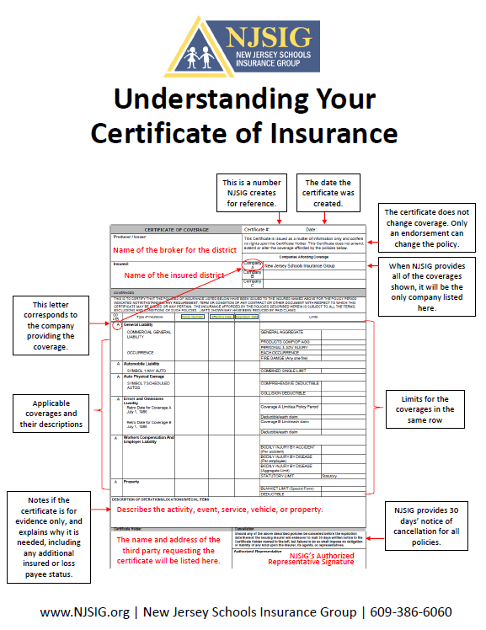
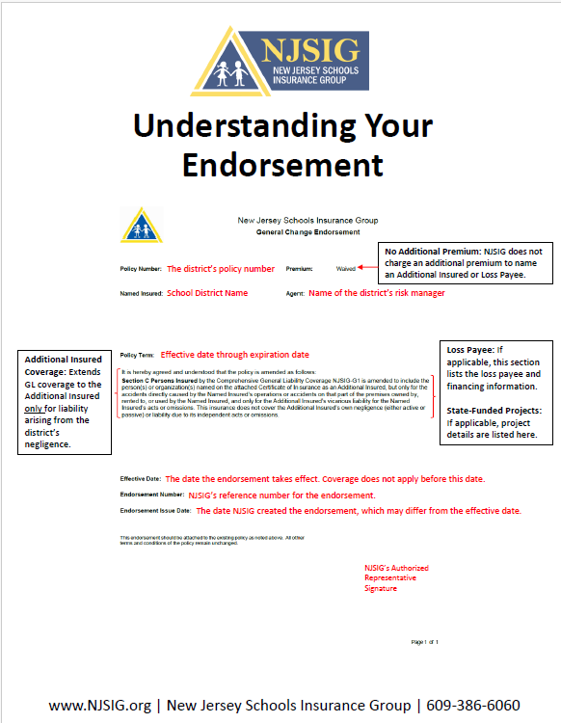
Understanding Your COI
Understanding Your Endorsement

Slide 38
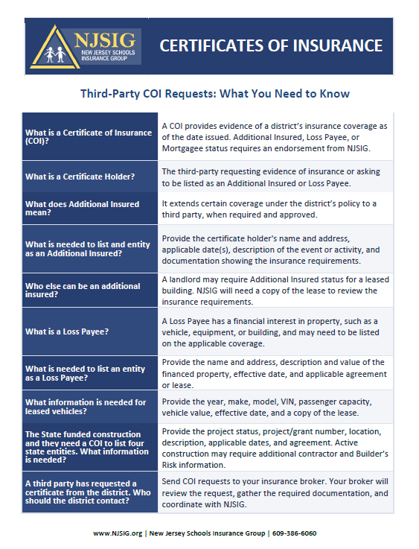
Third Party COI FAQ

Slide 39
What to Include
with Your Request
  Submit the related contract or agreement with your COI request.
  NJSIG Underwriting reviews:
    Insurance requirements
    Indemnification provisions
    Hold harmless language
  Recommended: Have your school board attorney review contracts for legal issues.

Slide 40
Additional Insured
& Primary / Non-Contributory
Additional Insured
  NJSIG provides coverage based on the member’s negligence.
  NJSIG does not provide coverage for liability caused by the Additional Insured’s own negligence.
Primary & Non-Contributory
  Primary: The applicable policy responds first.
  Non-Contributory: The policy responds without seeking contribution from another applicable policy.
  NJSIG does not provide blanket Primary & Non-Contributory coverage.
  Requests are reviewed case-by-case based on the contract or agreement.

Slide 41
Checklist for
Additional Insured Status
  NJSIG provides a checklist to help determine Additional Insured status for:
    PTAs
    PTOs
    HSAs
    Foundations
  PTAs, PTOs & HSAs
    Automatically covered as Additional Insureds when acting on behalf of and with approval from the school board.
    Business Administrators should ensure these groups understand the approval requirement.

Slide 42
Foundations: Additional
Insured Exceptions
  Foundations & affiliated 501(c)(3) organizations
    May qualify when acting under the school board’s direction.
    Additional Insured status may not apply if certain exposures or financial thresholds exist.
A foundation or affiliated 501(c)(3) organization may not qualify as an Additional Insured if, at the time of a claim:
    Annual revenue exceeds $100,000
    Total assets exceed $500,000
    The organization has employees
    Corporate sponsors receive marketing benefits
    The organization has child care exposure
    The organization has liquor liability / hosts liquor events
When in doubt, use the checklist.
Contact NJSIG or your assigned Underwriter for assistance.

Slide 43
Facility Use Agreements
  Ensure that all vendors using the facilities sign a use agreement.
    Specify the scope of the use of the facilities (including dates/times).
  Principles for a facility use agreement and a contract are the same!
    Secure a Certificate of Insurance with policy effective at the time of the
    use of facilities.
    Additional insured status.
    Hold Harmless / Indemnification language (Azurak Complaint if possible!)

Slide 44
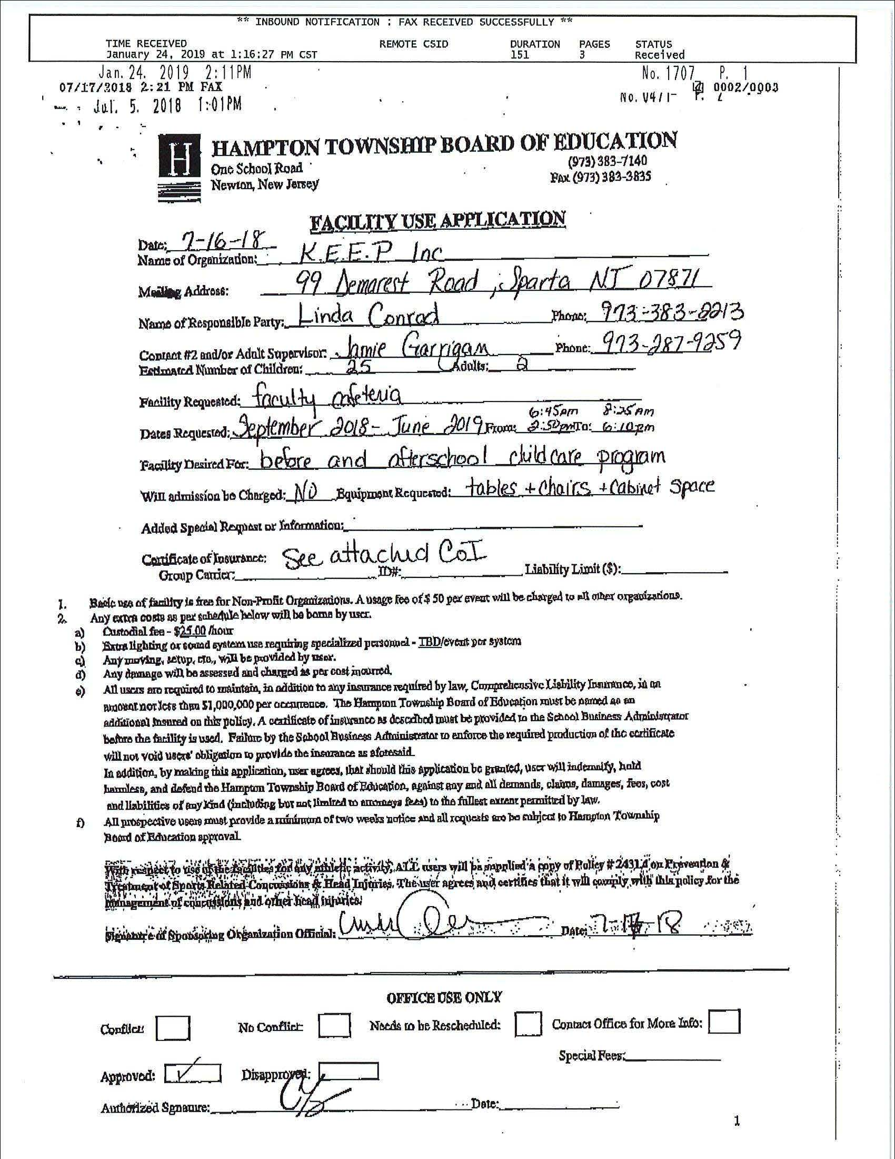
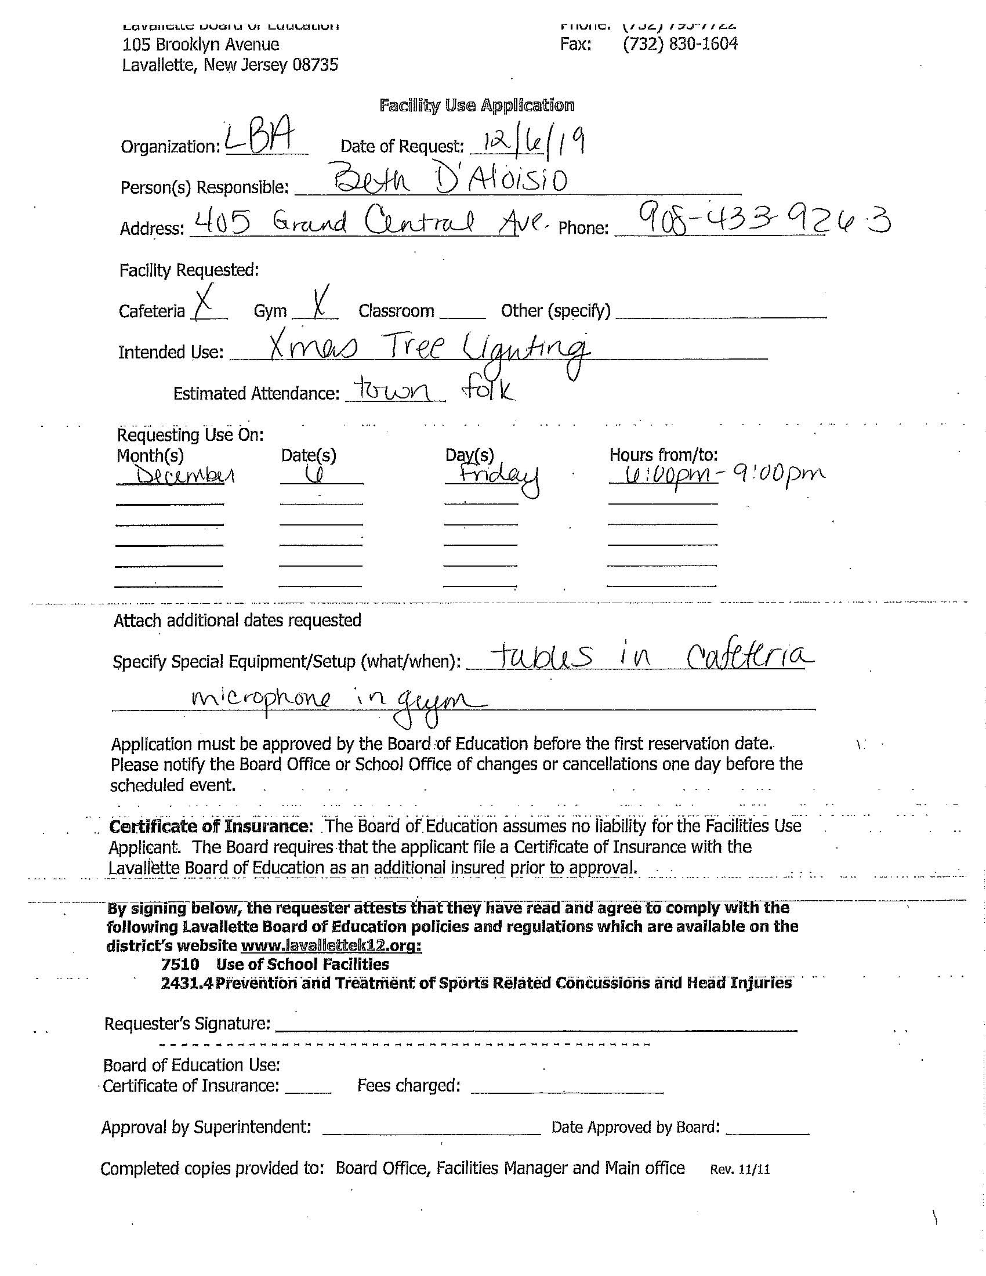
REDACTED: Name of School
REDACTED: Name of School
REDACTED: Name of School
Good Example:
Not So Good Example:
BOE Redacted
BOE Redacted
BOE Redacted
BOE Redacted
BOE Redacted
BOE Redacted

Slide 45
Other Contracting Considerations
Large Construction Projects – AIA Contracts
  Typically contains a full waiver of subrogation
    Have board counsel review before agreeing to waive subrogation rights, have Board Counsel review the provision and understand what rights the district may be giving up.
Use of Cooperative Purchasing Arrangements
  Do not assume the district has the same protections as with a direct contract.
  Who is reviewing vendors insurance policies/limits/language?
    Is the district an additional insured?
    Under whose policy?
    Held harmless?
    Indemnified?
  Board counsel needs to be consulted.

Slide 46
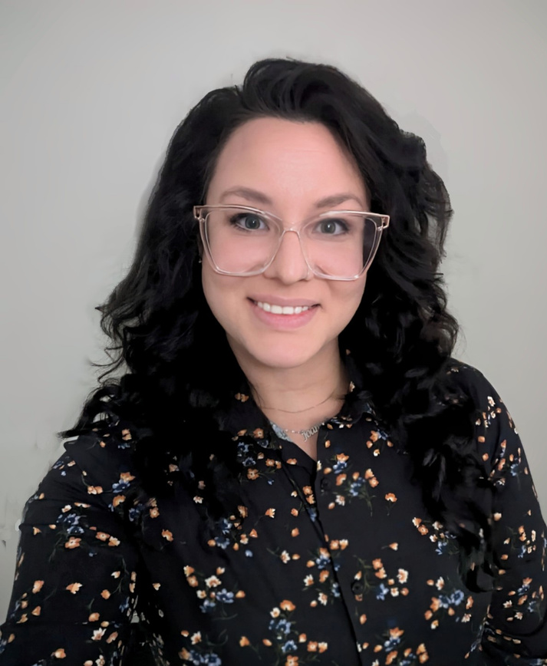
Managing Risk
Joanna Radomicki
NJSIG Senior Member Services & Loss Control Representative

Slide 47
The Risk Management Process
Identify - What are our risks?
Recognize potential exposures across the district:.
  Workers' Compensation
  Property
  General Liability
  Auto Liability
  E&O
  Cyber and other emerging risks

Slide 48
The Risk Management Process
Assess - How significant is the risk?
Consider:
  How likely is it to happen?
  How serious could the consequences be?
  Where are we seeing repeated losses or concerns?

Slide 49
The Risk Management Process
Treat - What can we do about it?
Choose the appropriate strategy: Avoid → Reduce → Transfer → Accept
NJSIG helps members reduce risk through services and resources such as:
  Property/Playground/Pre-QSAC Inspections
  Defensive Driving Training
  Return-To-Work Toolkit
  Vector Solutions Training
  NEPHA Hotline and other resources

Slide 50
The Risk Management Process
Monitor - Is it working?
Continue watching exposures and determine whether controls are effective.
NJSIG’s custom resources include:
  Trend Analyses
  Loss Runs
  Claim Reviews
  Safety Committee Support
  Risk Run Report

Slide 51
The Risk Management Process
Communicate - Keep everyone informed.
Risk management works best when information gets to the people who can act on it.
Examples:
  SafetyNet Newsletter
  NJSIG Updates
  Trainings and Webinars
  Member Resources and Toolkits
  Workers’ Compensation Toolkit

Slide 52
Preparing for Tomorrow
Upcoming Trainings & Meetings
All meeting dates have been scheduled and offer QPA credits. Please register!
NJEIF Sub-fund Meetings | NJEIF Learning Opportunities
Friday, January 8, 2027 | VIRTUAL | 9am – 11:30am Hot Topics in School Law Attorney Champion Matthew J. Giacobbe, Esq. NJSIG NEPHA Hotline Credits: 2 QPA Credits 1) Ethics and 1) Office Administration / General Duties | Thursday, February 25, 2027 | 10am to 12pm NJ’s Law Against Discrimination in the Workplace NJ Division on Civil Rights
Thursday, April 22, 2027 NJEIF Sub-fund Meeting School Security with Office of School Preparedness & Emergency Planning Details to follow. | Thursday, March 25, 2027 | 10am to 12pm Reasonable Accommodations in the Workplace & the Law Against Discrimination NJ Division on Civil Rights
Stay up-to-date by visiting: https://www.njsig.org/sub-funds/njeif

Slide 53
Training Thursdays with
NJ Division on Civil Rights
Reasonable Accommodations in the Workplace & the Law Against Discrimination
NJ’s Law Against Discrimination
in the Workplace
Thursday, February 25, 2027 | 10am to 12pm
Explore how New Jersey’s Law Against Discrimination protects employees—and what supervisors need to know. Through real-world scenarios, participants will tackle discrimination, harassment, accommodations, retaliation, wage equity, and the supervisor’s role in creating a fair and inclusive workplace.
Thursday, March 25, 2027 | 10am to 12pm
What does a reasonable accommodation really look like in the workplace? Through real-world scenarios and interactive exercises, this training explores NJLAD requirements, the interactive process, disability and pregnancy accommodations, undue hardship, telework, and other common accommodation challenges.
Contact Latonya Brennan for registration links.

Slide 54

NJSIG @ NJSBA Workshop 2026
NJSIG Presentations
Board Ethics: Risks & Realities Presenters: Sherwin Archibald Rita Barone, Esq. Tuesday, October 20, 2026 9:30am – 10:30am 1:00pm – 2:00pm Room 420 Continuing Education Credits: .5 Board Member Academy 1 Qualified Purchasing Agent – Ethics | Navigating Special Education Claims: Pitfalls & Best Practices Presenters: Anthony Fernandez Eric Harrison, Esq. Wednesday, October 21, 2026 11:30am – 12:15pm 2:00pm – 2:45pm Room 313 Continuing Education Credits: .25 Board Member Academy

Slide 55
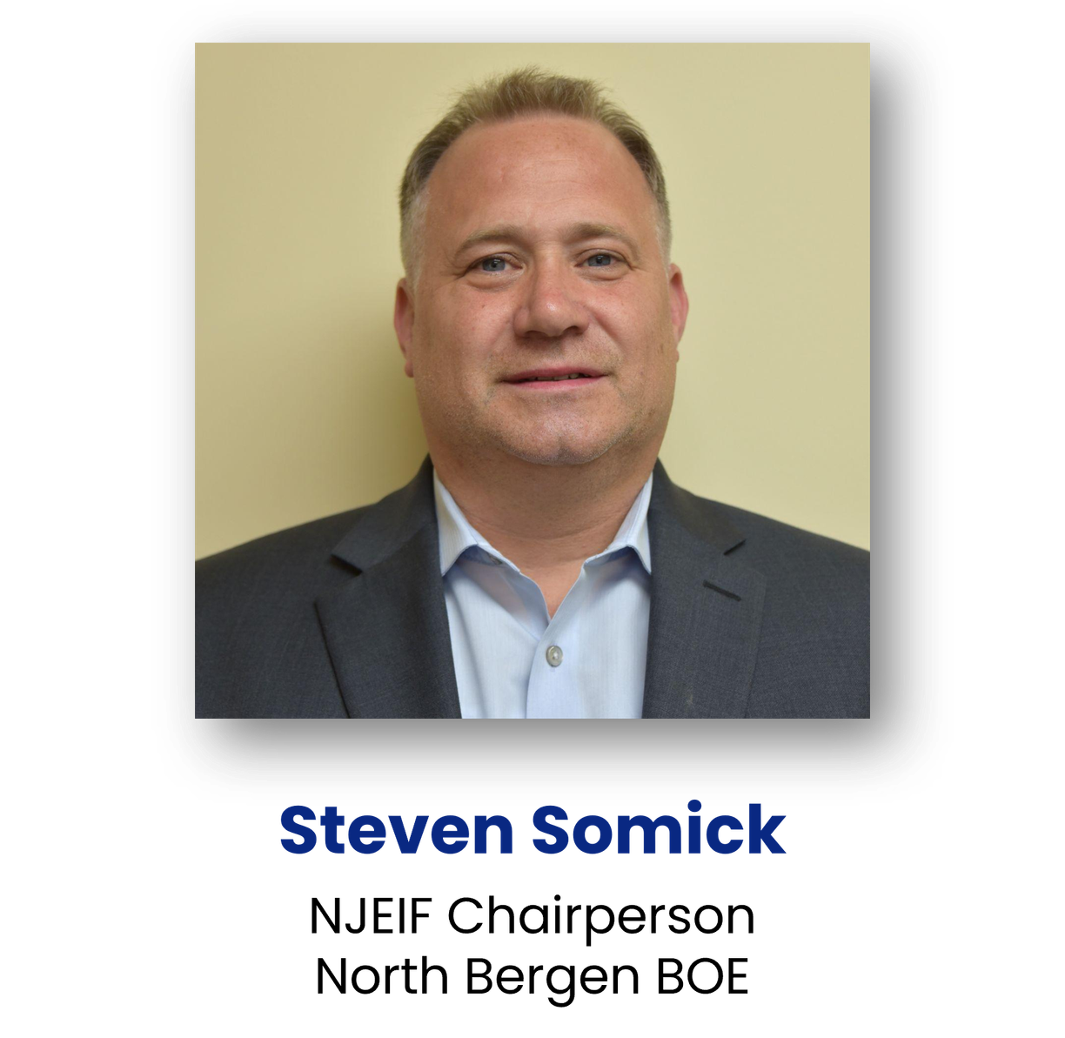
Closing
Steve Somick
NJEIF Chairperson
School Buisness Administrator
Board Secretary
North Bergen BOE

Slide 56

Thank You!
Certificates will only release at the end of the program and receipt of Completed Evaluation Form.
If you have any questions feel free to connect with us.
Joanna Radomicki
jradomicki@njsig.org
www.NJSIG.org
NJSIG Senior Member Services
& Loss Control Representative

